Slide 1

Data Compression – Comparing Haar Algorithms
Presenters: Liel Berniker, Noy Osi, Dvir Segal Instructor: Prof. Dana Shapira

Slide 2
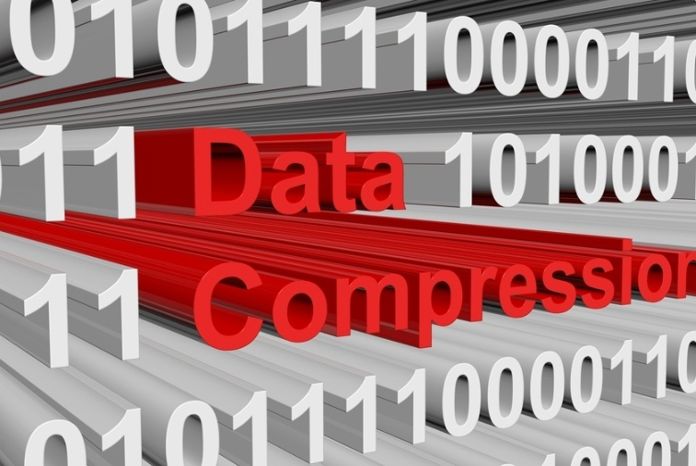
What is data compression?
Data compression is the process of encoding, restructuring or otherwise modifying data in order to reduce its size

Slide 3
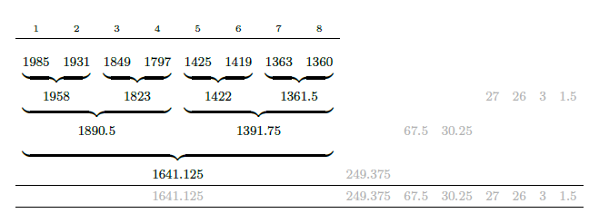
Haar wavelet transform
The Haar wavelet transform is a simple discrete transform, used in practical encoding applications such as the compression of digitized sound and images.
Here it is applied for lossless compression of integer sequences.

Slide 4

Haar algorithms:
Haar Integer
Haar New Transform.

Slide 5
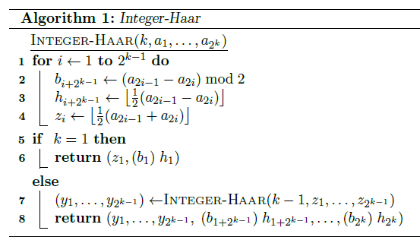
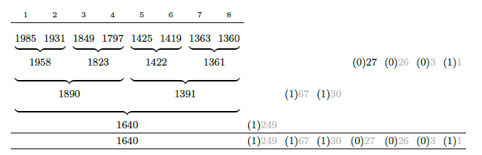
Integer-Haar:
Integer-Haar: To restrict the processing to deal with integers only,
a single flag bit can be adjoined to every half-difference,
indicating whether or not the value has been rounded downwards.
Example 1:

Slide 6
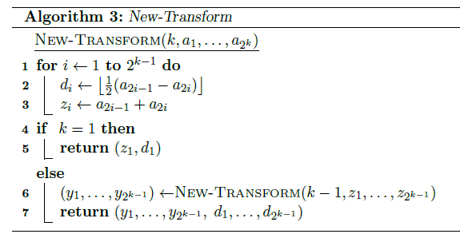







Haar New Transform :
Haar New Transform: Instead of computing the averages of the number pairs in the input sequence,
it only sums up the corresponding elements.
Example 2:

